Slide 1



CREWES Data Science
Lecture 7: Github and Projects Setup
Marcelo Guarido
www.crewes.org

Slide 2

Today's Agenda
Part 1:
Git
Part 2:
GitHub
Part 3:
GitHub Desktop
Part 4:
Projects Setup

Slide 3


Part 1:
GIT

Slide 4
Git
Git is a software used for tracking changes in any set of files that are stored locally or remotely. This type of software is also called "version control system". It is widely used among programmers to work collaboratively when developing source code.
Git is the most commonly used version control system and is used for:
Tracking changes in a file
Reverting the changes to a specific previous version
Collaboration among multiple users

Slide 5
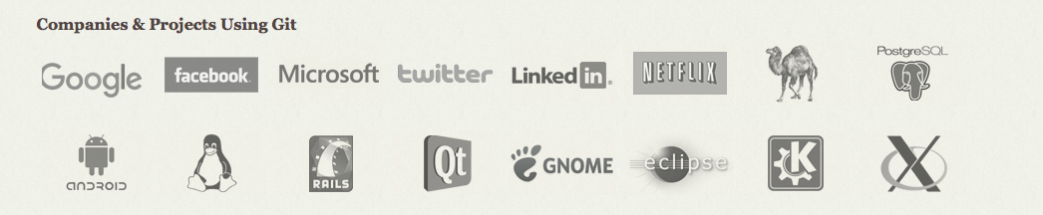

Slide 6

Git

Slide 7
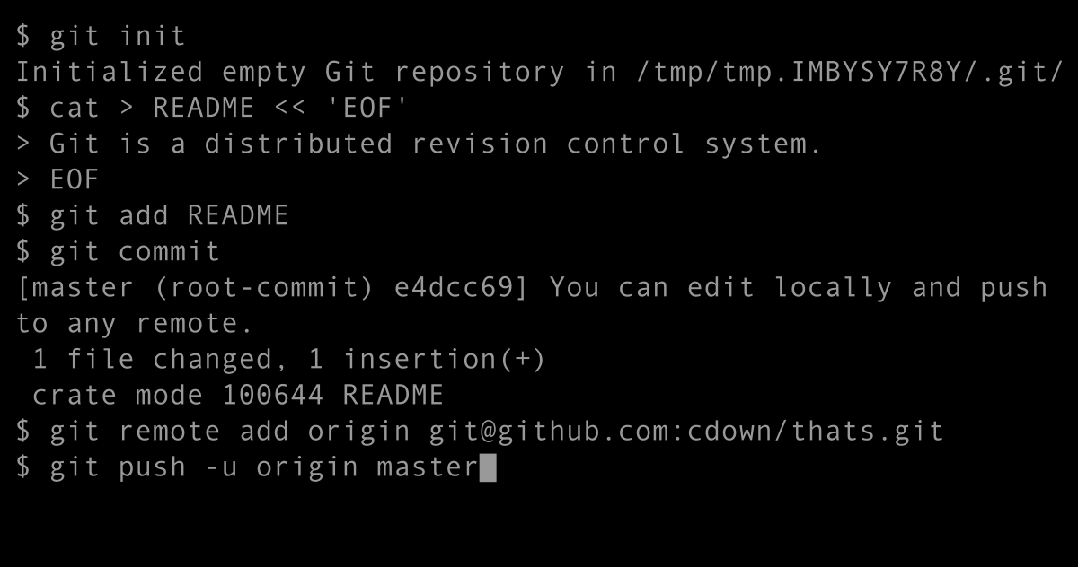
Git
The most common way to use git locally is with command lines in a terminal (usually in Linux and MacOS).

Slide 8
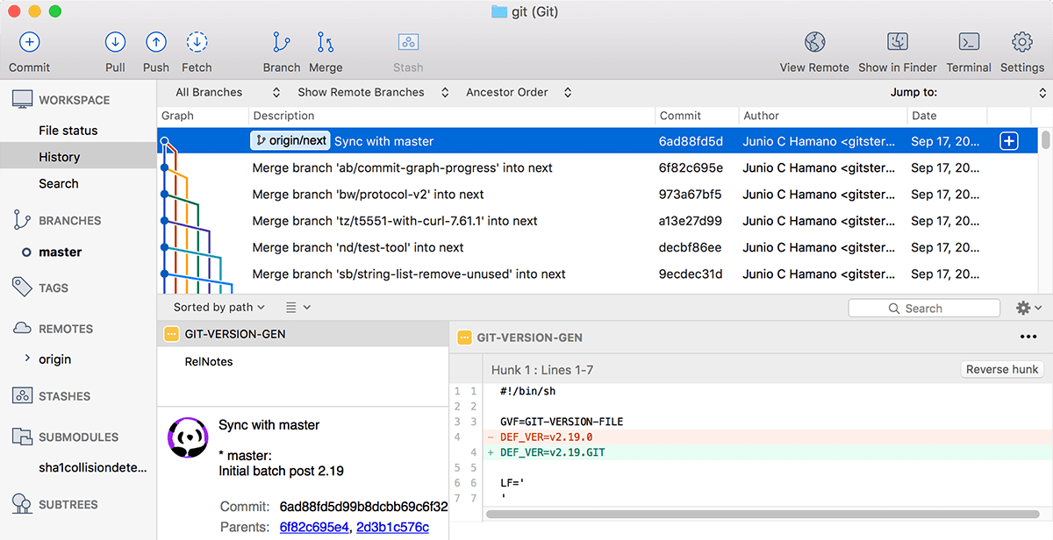
Git
There are different GUIs (graphical user interface) that makes git usage simpler for all types of users, such as the Sourcetree (above) or the GitHub Desktop.

Slide 9

Git Repository
The first step of Git is to create a repository (usually locally). For that, we can create a new folder or use an existing one, and we need to tell Git to make it a repository. It will then create a .git subfolder, which contains all the metadata for tracking changes in files.
.git is a hidden folder.
We can use the metadata information to send the changes in files to a remote repository (GitHub, BitBucket, etc.).

Slide 10
Git Commit
Git keeps a list of changes to files, but not any change. We need to tell Git when to record our changes. And it is done in two steps:
Staging: when we use the command add to select which files we want to record the changes. This is useful, as not always we want to record changes in all the files in the repository.
Commit: the command commit records the changes of the selected files.

Slide 11
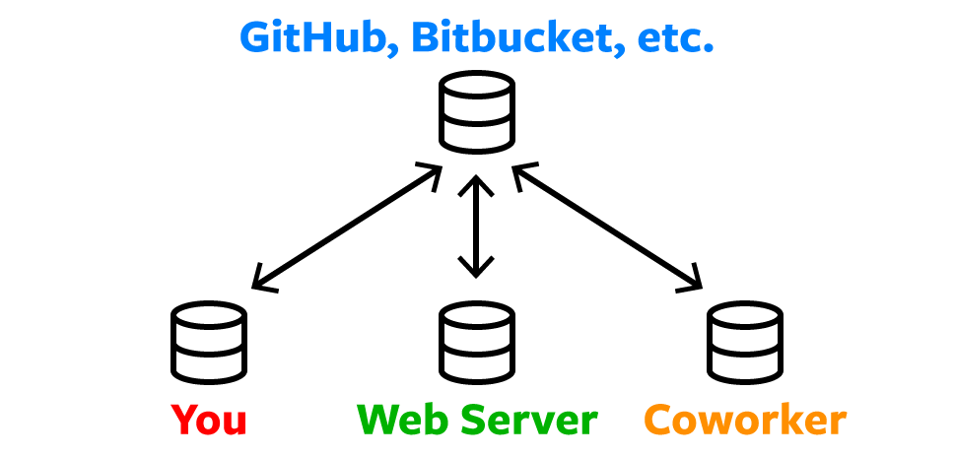






Remote Repositories
There are online hosts (GitHub, Bitbucket, GitLab, etc.) where we can upload our repositories to the cloud. With that, there are more commands we use in git:
push: upload the repository to the server
pull: download a repository to a local machine.

Slide 12
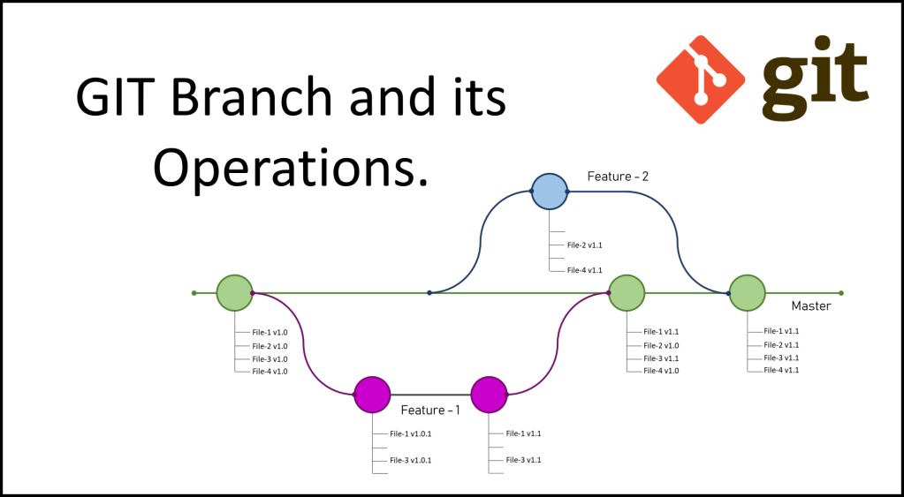
Git Branch
Git provide the branch option, creating a new path for different programmers to develop a code for posterior merging in the master.

Slide 13
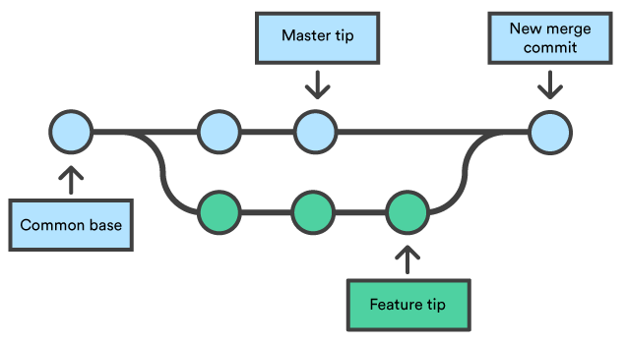
Git Merge
Merging different branches to the master is possible, and different developed parts of a code (different changes) are combined together. Conflicts may occurs if changes were done in the same lines of code, but Git provides a way to handles such conflicts and the programmers can decide which one to proceed with.

Slide 14
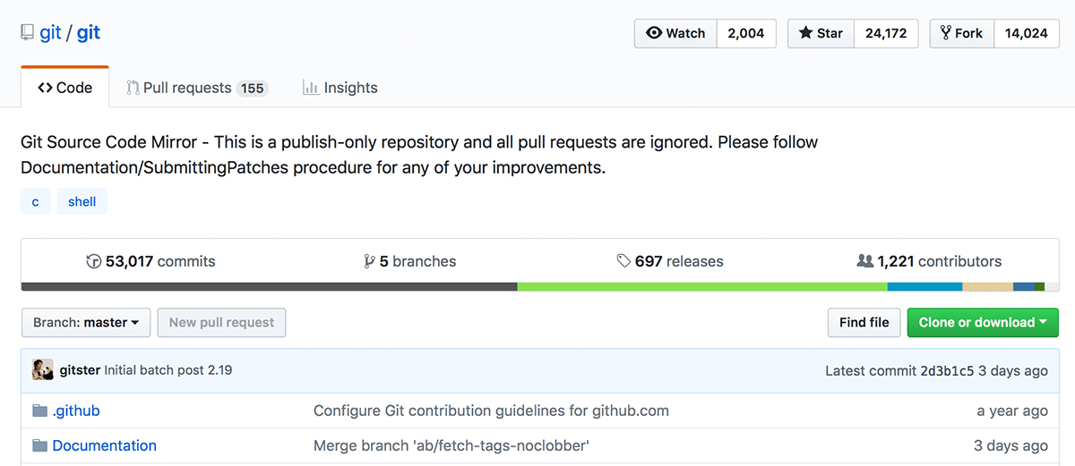
Pull Requests
Pull requests are a safe way for merges not be done for any programmer whenever they want, to avoid instability. When a pull request is made, programmers can discuss about the changes and decide if they will proceed with it.

Slide 15

Part 2:

Slide 16

GitHub
One of the most used git repository remote host
Works with Git commands
Upload repositories to the cloud
Public or private repositories
Used for many as a portfolio presentation
Owned by Microsoft

Slide 17

Part 3:
GITHUB DESKTOP

Slide 18
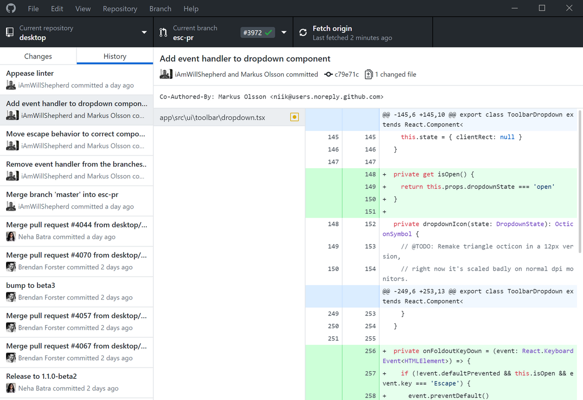
GitHub Desktop
GUI implementation of Git
Does not use command line (no terminal)
Simple to use
For new to hardcore users
For Windows and MacOS

Slide 19

Part 4:
PROJECTS SETUP

